Slide 1




03 March 2026
Econet InfraCo Website Monthly Report Analysis

Slide 2


03 March 2026
Areas Of Focus:
What Is The Purpose Of This Report?
Key metrics
Audience Demographics
Page Sessions
Performance Overview
Conclusion
The purpose of this report is to analyse and assess The performance Of the Econet InfraCO website for the month of February 2026.

Slide 3
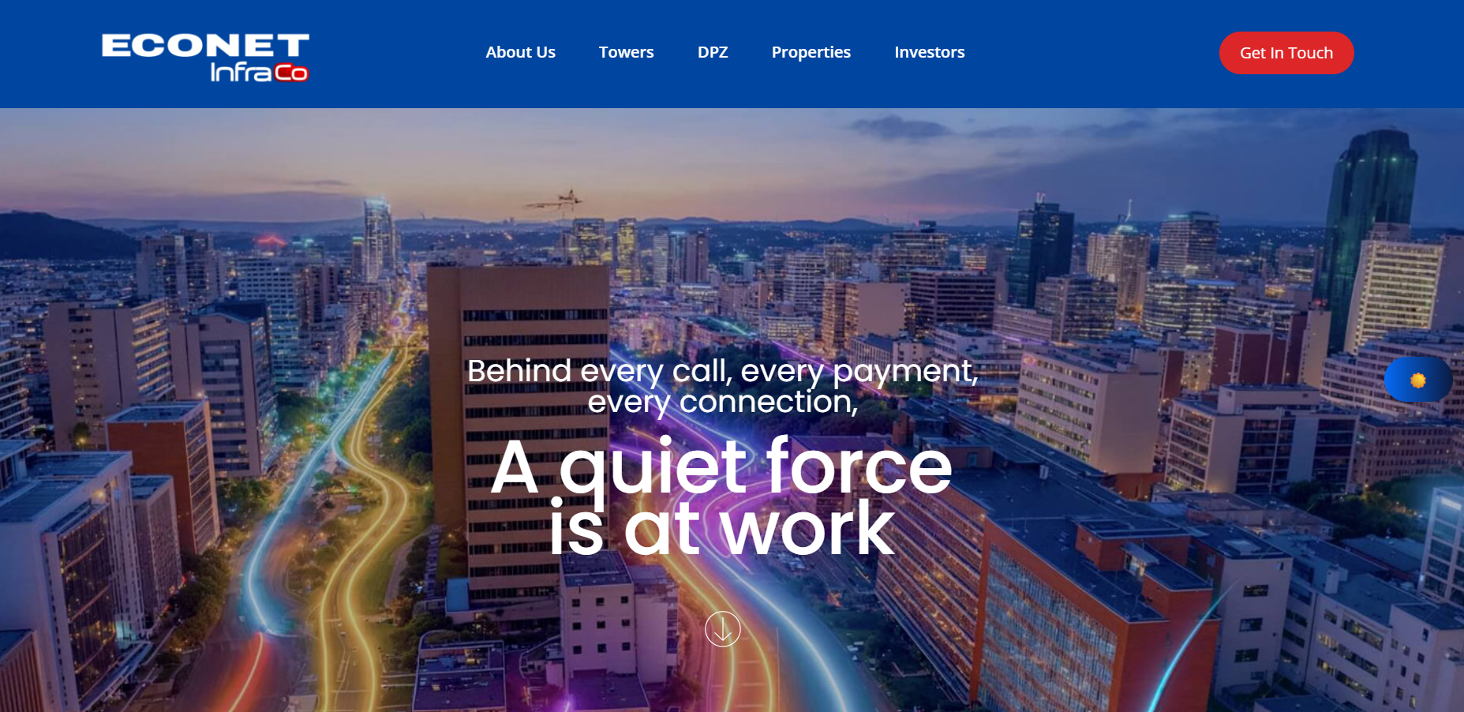
03 March 2026
Summary
Performance of the website based on data insights
In February 2026, the site garnered a total of 9,02K impressions, with 22K users navigating through it. The landing page was the most visited followed by the About page. Notably, Zimbabwe still has the highest number of users 18,8K, followed by United States 719 users.

Slide 4
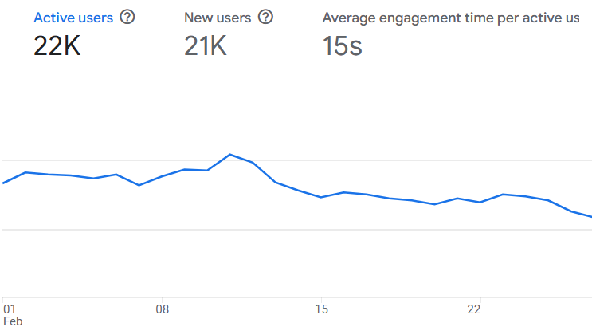
03 March 2026
Site Overview
Highlighting the significant numerical indicators, the large line chart to the right showcases the key metrics for the Econet InfraCo Website during February 2026.
It shows:
Users : 22K total users visited the site.
New Users : 21K new users, which indicates that most visitors were first-time visitors.
Average Engagement Time : Users spent an average time of 15 seconds on the site.

Slide 5
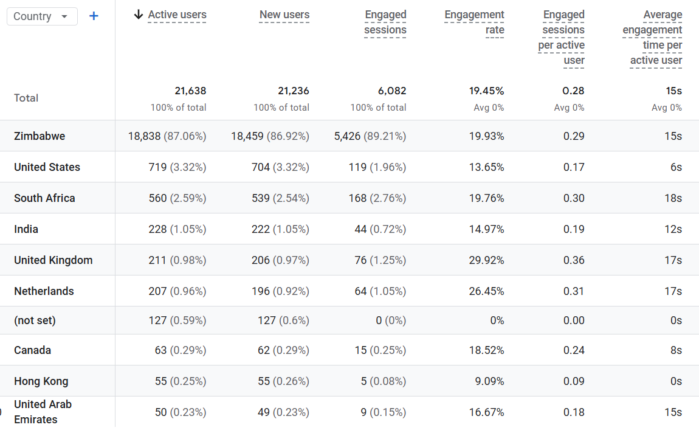
03 March 2026
Demographic Overview
During February 2026, most of the traffic came from Zimbabwe (18,8K users) , followed by United States with (719 users) and South Africa with (560users)​ ​

Slide 6
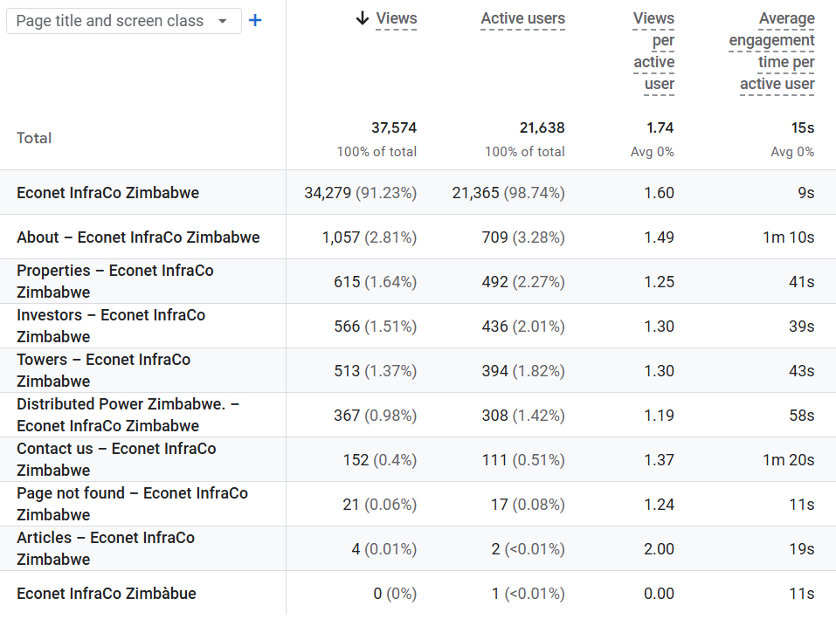

03 March 2026
Pages Sessions
The table shows the top pages visited by users in February 2026

Slide 7
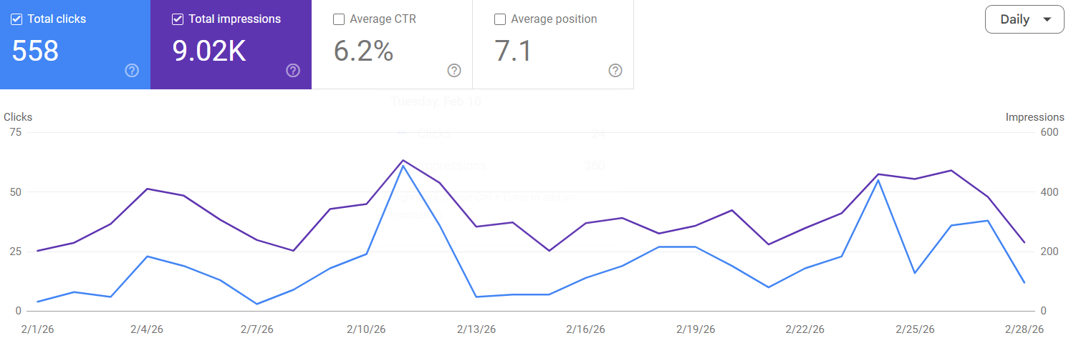
03 March 2026
Performance Overview
The website received a total of 558clicks, meaning that some users visited the site from search engine results. The website appeared in search results 9,02K times, referred to as "impressions." The average click-through rate (CTR) was 6.2%, indicating the percentage of impressions that resulted in clicks. Additionally, the website's average position in search results was 7,1

Slide 8
03 March 2026
Conclusion
The Econet InfraCo Website had a high number of Active Users (22K) with the most visited page being the Home page (34.3K).

